Slide 1
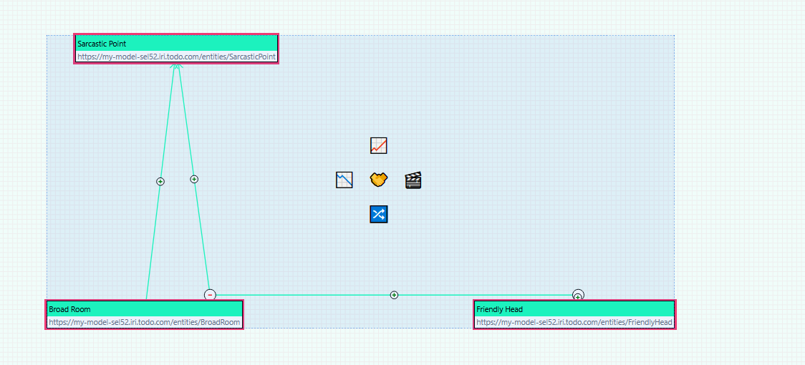

Slide 2
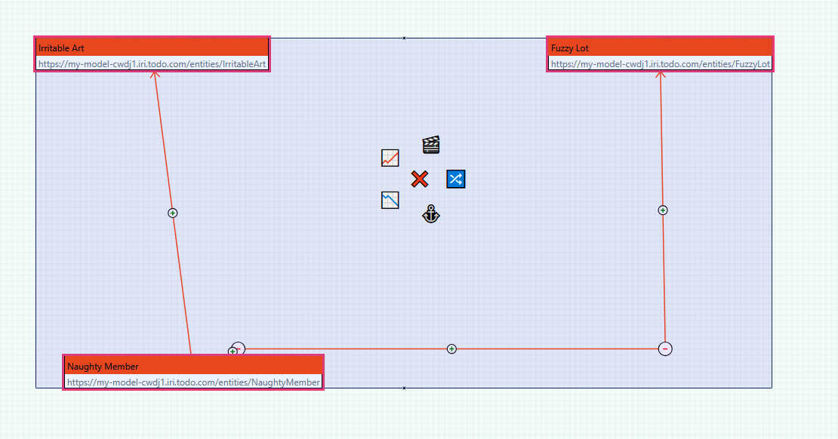

Slide 3
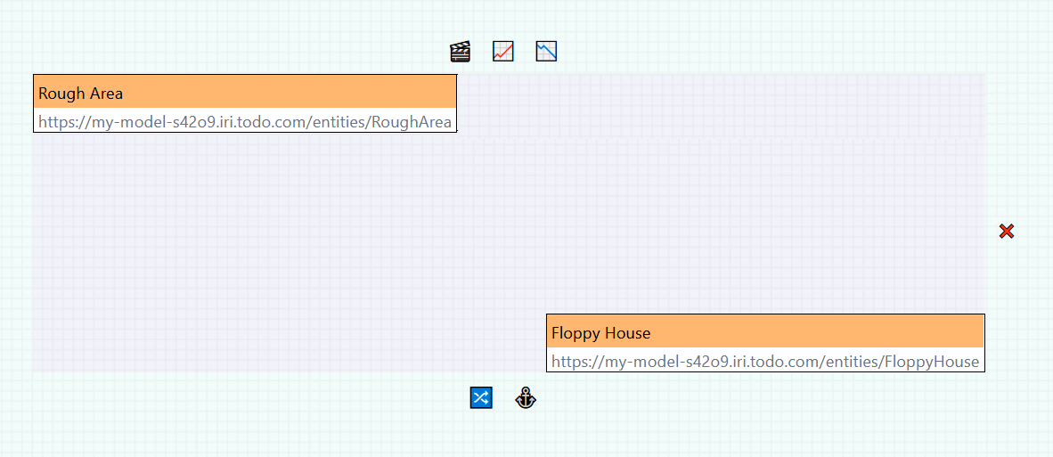

Slide 4
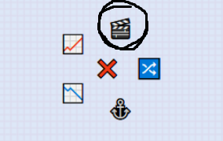

Slide 5


Slide 6
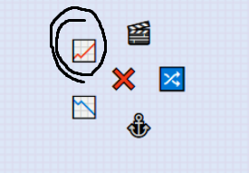

Slide 7
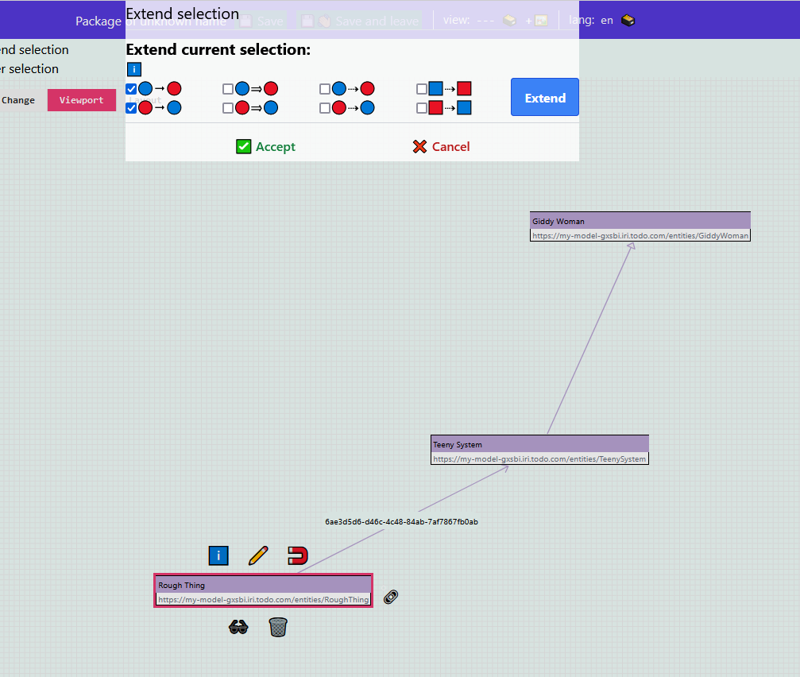

Slide 8
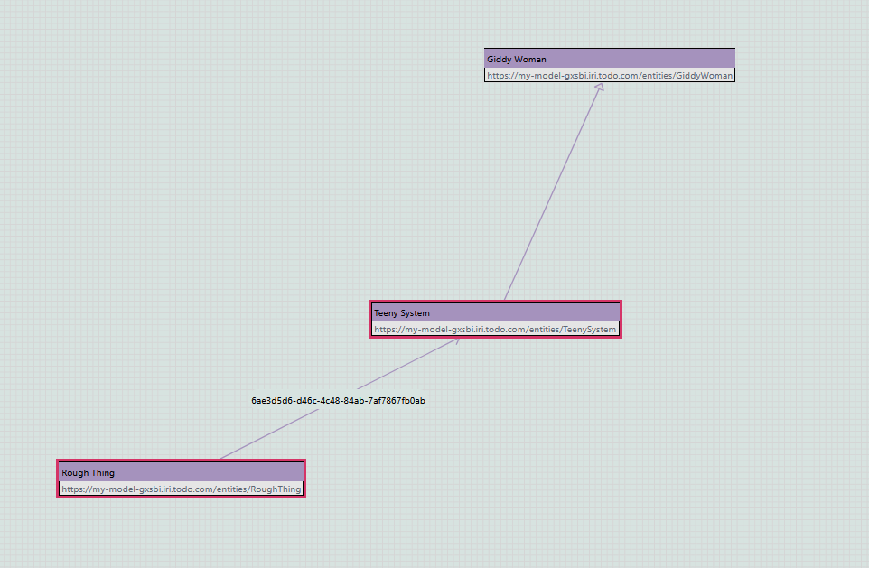

Slide 9
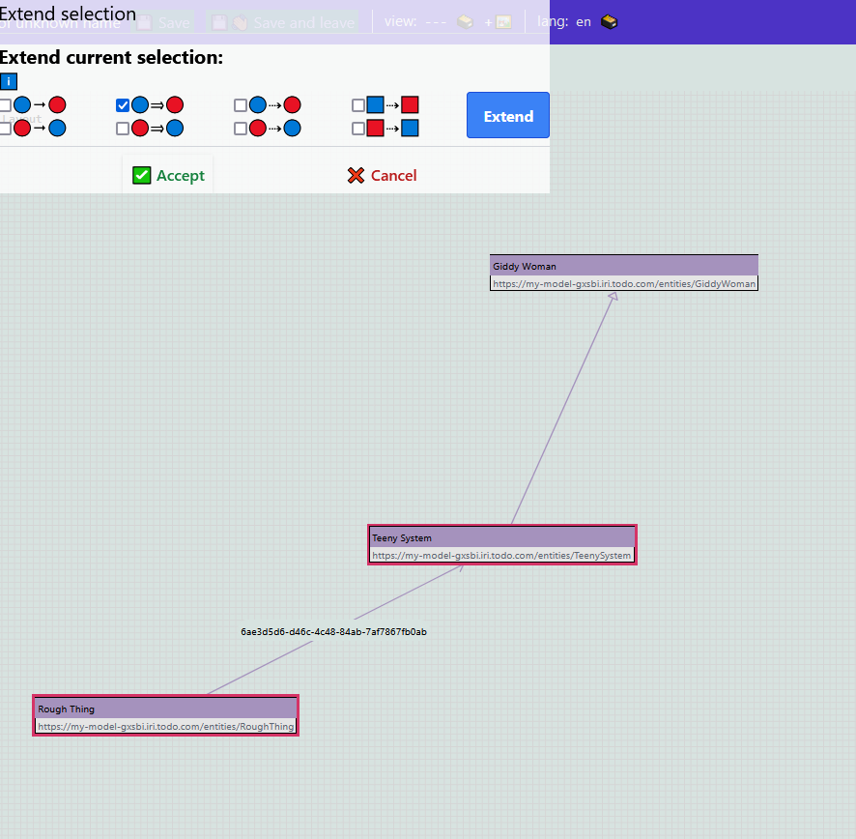

Slide 10
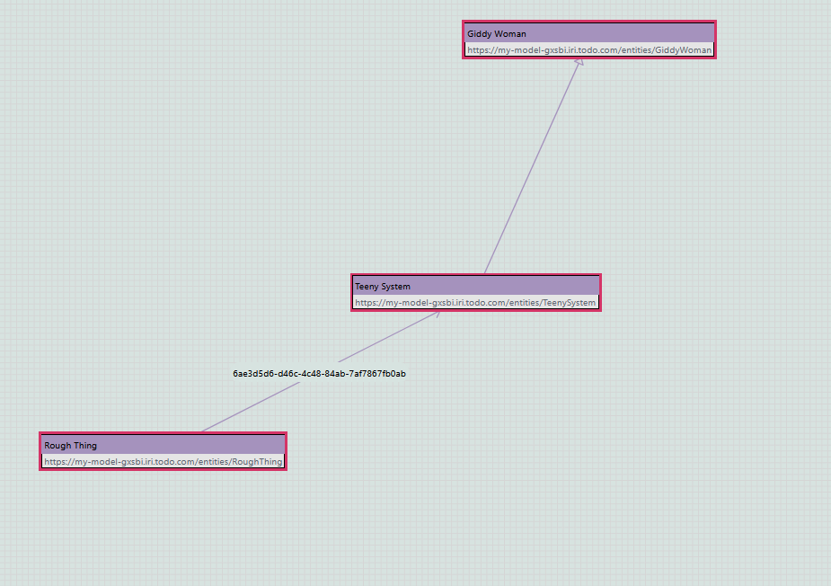

Slide 11
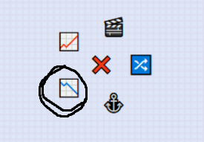

Slide 12
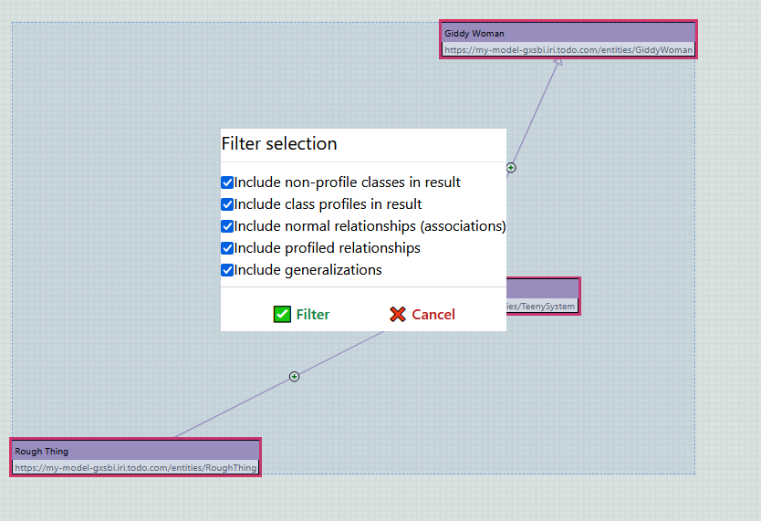

Slide 13
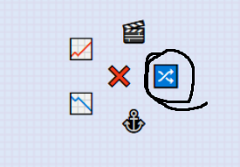

Slide 14


Slide 15


Slide 16


Slide 17


Slide 18
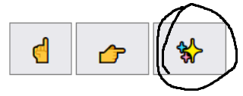

Slide 19
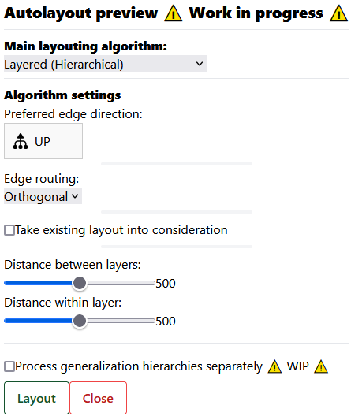

Slide 20
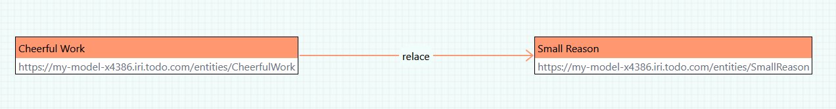
Profilování selekce

Slide 21
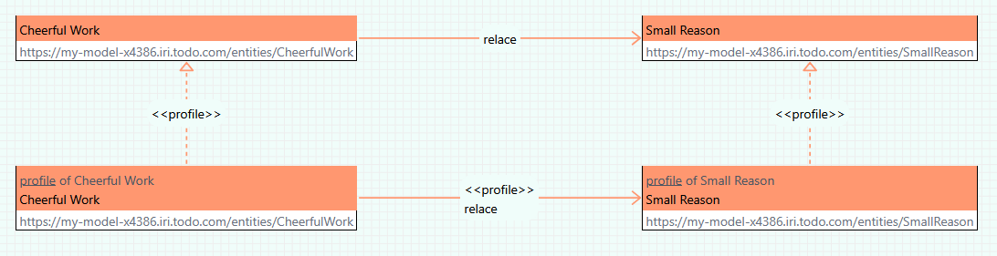

Slide 22
https://github.com/mff-uk/dataspecer/blob/eb9b45b09cd1a6ae2409fd9ad3c0346557cde6a8/applications/manager/src/dialog/autolayout.tsx#L61
https://github.com/mff-uk/dataspecer/blob/eb9b45b09cd1a6ae2409fd9ad3c0346557cde6a8/packages/core-v2/src/visual-model/entity-model/default-entity-model.ts#L193

Slide 23
